Slide 1

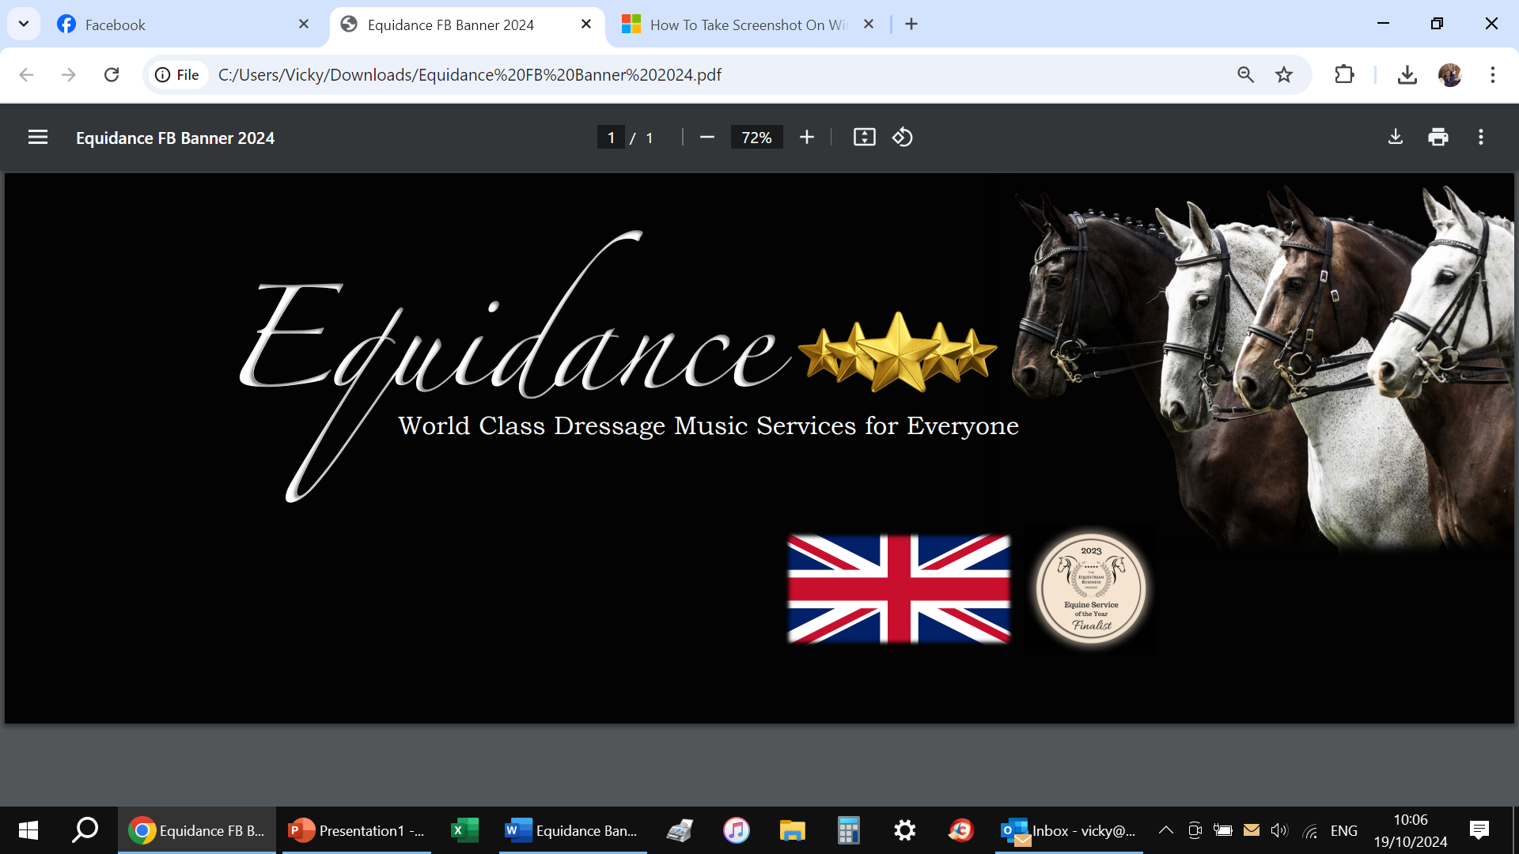
DRESSAGE TO MUSIC
Ever wanted to start Dressage to Music but don’t know where to start ?
Inspired by Olympian Beccy Moody and Jaegerbomb ?
Come and find out how to start !
Bewdley Bridle Club
presents
Tony Hobden of
Sat November 30th
7pm start
The Queens Head, Wolverley DY11 5XB
Members £5
Non Members £10
Booking / more info Vicky@bardleybowen.co.uk

